Slide 1
DESIGN AND FABRICATION OF SMART IRRIGATION SYSTEM
BATCH V
AKASH V M-727721EUMC009
BAVITHRAN R S-727721EUMC022
AKILESWAR K-727721EUMC010

Slide 2
TABLE OF CONTENTS
Project description
Project layout
Detailed description
COMPONENTS USED
APPLICATIONS IN REAL LIFE
FUTURE DEVELOPMENTS

Slide 3
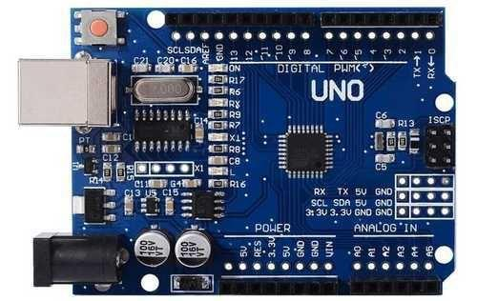
PROJECT LAYOUT
Our project introduces a Smart Irrigation with Fertilizer Feeding System, aiming to streamline plant care processes using automation. The system operates by incorporating several key components to ensure efficient watering and nutrient supplementation for plants.
A soil sensor detects dryness, activating a submersible pump to hydrate plants. A fertilizer hopper supplements nutrients through a T-joint with water output. Users control fertilizer release via a smartphone app linked to a Bluetooth module. Real-time soil moisture feedback is displayed on an LCD, ensuring optimal plant health and growth.
Arduino uno is the microcontroller board which is used ,that is the brain of the system.

Slide 4
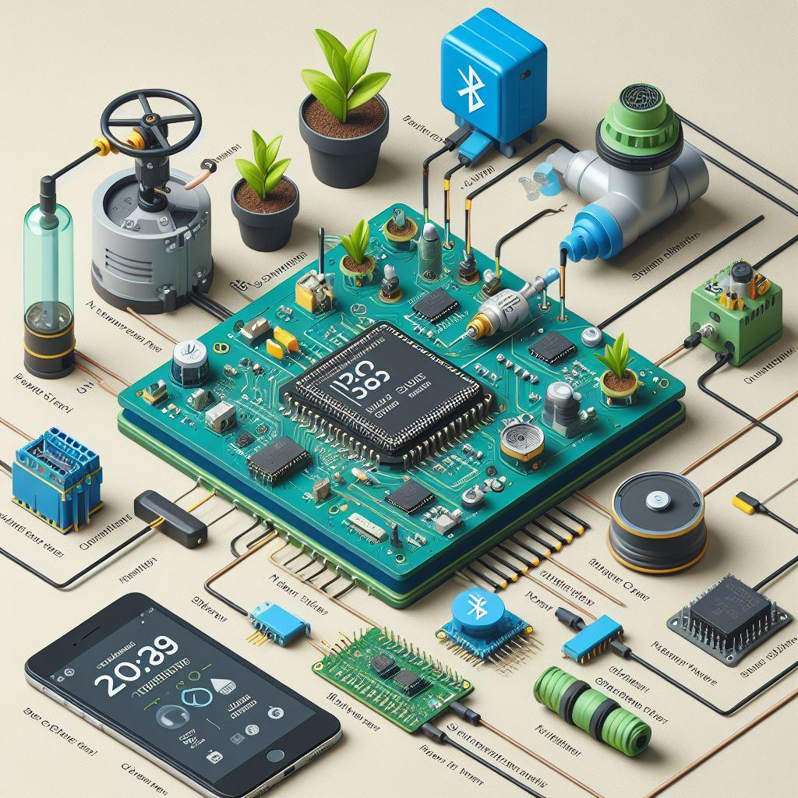
PROJECT LAYOUT
Sensor Placement:
Sensor embedded in soil for direct moisture monitoring.
Pump Installation:
Pump adjacent to water source for efficient water delivery.
Fertilizer Hopper Integration:
Hopper positioned above water source for gravity-fed nutrient supplementation.
Bluetooth Module and Smartphone Interaction:
Bluetooth module enables wireless control via smartphone app.
Valve Positioning:
Valve regulates fertilizer flow downstream from hopper.
LCD Display Mounting:
Display mounted for real-time soil moisture feedback.
Arduino Microcontroller Placement:
Microcontroller housed centrally for efficient communication.
Wiring Management:
Neat wiring organization for system reliability.

Slide 5
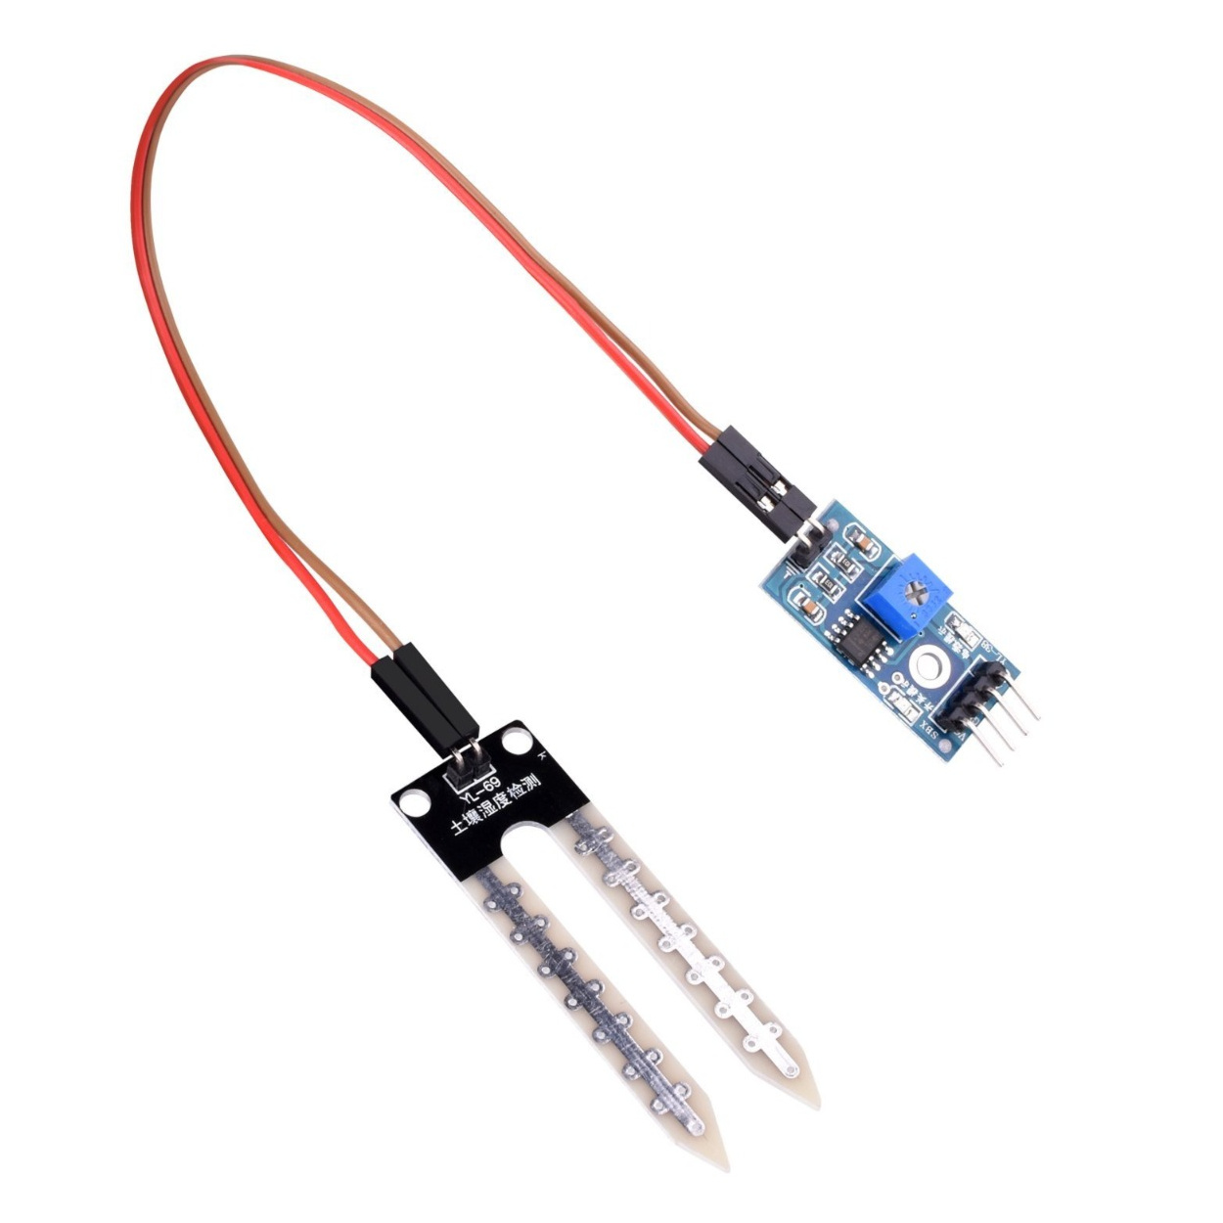
DETAILED DESCRIPTION
Arduino Uno Microcontroller Board:
The Arduino Uno is a popular microcontroller board based on the ATmega328P microcontroller. It serves as the brain of the smart irrigation system, controlling the operation of various components based on sensor inputs and user commands.
Soil Moisture Sensor:
The soil moisture sensor measures the moisture content in the soil by detecting changes in electrical conductivity. It typically consists of two electrodes that are inserted into the soil. The sensor provides analog output proportional to the soil moisture level, allowing the Arduino Uno to determine when watering is required.

Slide 6
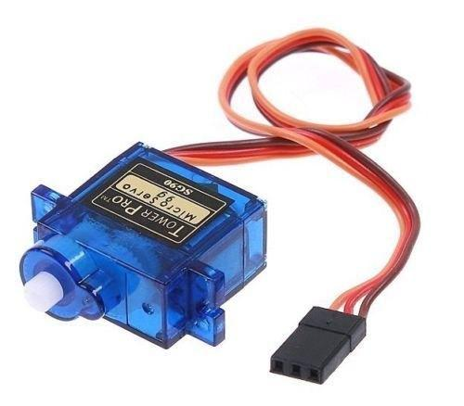
DETAILED DESCRIPTION
LCD Display:
The LCD (Liquid Crystal Display) display provides visual feedback by showing real-time soil moisture values. It typically consists of a display module and a backlight, allowing users to monitor the moisture status of the plant without needing to access the Arduino Uno directly.
Servo Motor:
The servo motor is a rotary actuator that allows precise control of angular position. In this project, the servo motor is used to control the opening and closing of the hopper for fertilizer feeding. It can rotate to a specific angle based on commands received from the Arduino Uno or the custom-developed smartphone application.

Slide 7
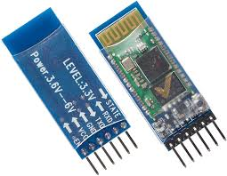
DETAILED DESCRIPTION
Submersible Water Pump:
The submersible water pump is used to deliver water to the plant when the soil moisture level drops below a certain threshold. It is typically submerged in a water reservoir and activated by the Arduino Uno to pump water to the plant roots via a tubing system.
Bluetooth Module:
The Bluetooth module enables wireless communication between the Arduino Uno and a smartphone. It allows users to remotely control the servo motor for fertilizer distribution using a custom-developed smartphone application. The Bluetooth module typically interfaces with the Arduino Uno via serial communication.

Slide 8
DETAILED DESCRIPTION
Soil Moisture Sensing: The system continuously monitors the moisture level in the soil using the soil moisture sensor. The sensor provides analog output corresponding to the moisture level, which is then processed by the Arduino Uno.
LCD Display: Real-time soil moisture values are displayed on the LCD display, providing users with immediate feedback on the moisture status of the plant.
Automatic Watering: When the soil moisture level falls below a predefined threshold (e.g., 1000), indicating that the plant needs watering, the Arduino Uno activates the submersible water pump. The pump delivers water to the plant until the moisture level reaches the optimal range.
Fertilizer Feeding Mechanism: The system includes a servo motor-controlled hopper for fertilizer distribution. Users can control the opening and closing of the hopper via a custom-developed smartphone application.
Bluetooth Connectivity: The Arduino Uno is equipped with a Bluetooth module, allowing it to establish a wireless connection with a smartphone. The custom-developed smartphone application provides users with a user-friendly interface to remotely control the servo motor for fertilizer feeding.

Slide 9
WORKING
1.Upon startup, the system activates and immediately begins monitoring soil moisture levels to ensure plants receive adequate hydration.
2.The LCD screen displays current moisture values, providing users with instant updates on the plant's moisture status for proactive plant care.
3.If the soil moisture drops below a set threshold, signaling the need for watering, the system triggers the water pump to supply water to the plant roots, ensuring timely hydration.
4.Users can remotely control the fertilizer hopper through a dedicated smartphone application, adjusting distribution based on plant needs and growth stages.
5.The smartphone application offers users a user-friendly interface to control fertilizer distribution, and receive real-time updates on the plant's condition.
6.The system continuously monitors soil moisture and fertilizer distribution, dynamically adjusting parameters to maintain optimal plant health and growth, providing a seamless user experience via the smartphone app.

Slide 10
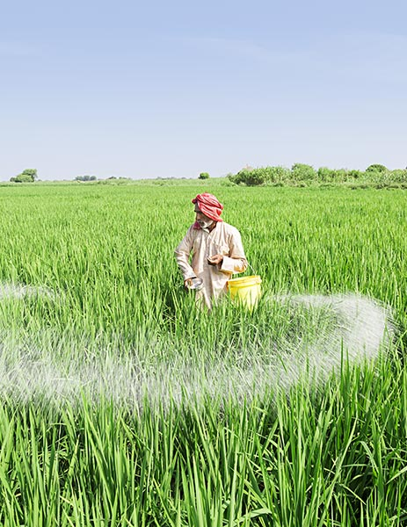
What is the Primary objective? – “ TIME ”
In the past, farmers would allocate considerable time to the labor-intensive task of fertilizing their crops manually. This process involved meticulous calculations, precise measurements, and repetitive application, all of which demanded significant time and effort. Additionally, the need to halt irrigation activities to administer fertilizers meant that valuable moments during optimal watering periods were lost.
However, with the innovative approach of infusing fertilizer directly into the water channel used for irrigation, a remarkable transformation occurs. This seamless integration eliminates the need for separate fertilization activities, effectively slashing the time required to nourish crops. Farmers no longer need to pause irrigation routines, as the essential nutrients are effortlessly delivered alongside the water, ensuring continuous nourishment for plants without interruption.

Slide 11
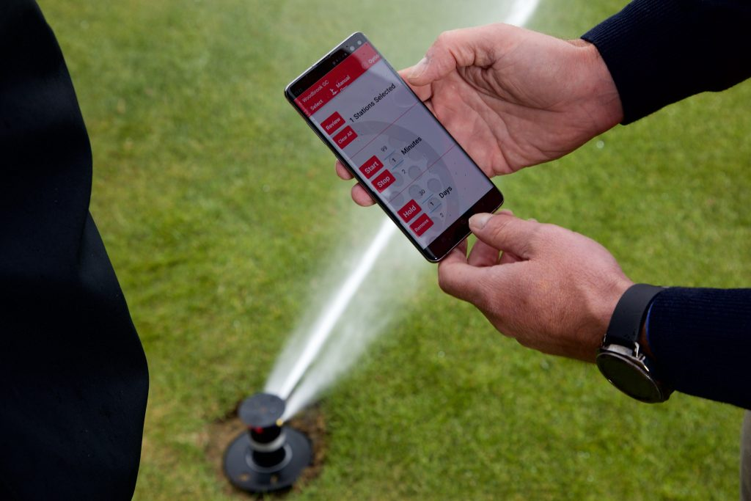
Outcomes and Applications
Water Conservation
Crop Health Monitoring
Disease Prevention
Energy Efficiency
Remote Monitoring and Control
Drought Management
Data-Driven Decision Making

Slide 12
THANK YOU

